Slide 1
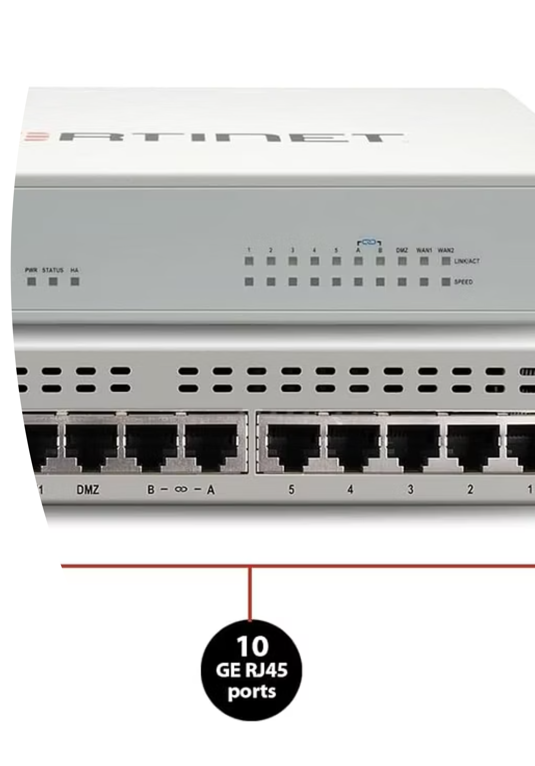
FortiGate Security Profiles: Enhancing Network Protection

Slide 2
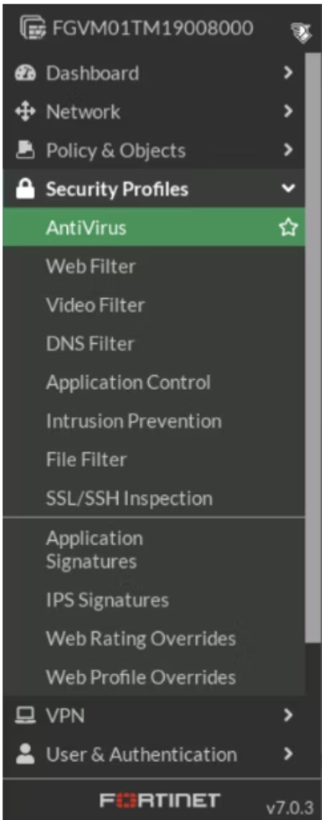



What are FortiGate security profiles?
In FortiGate, firewall policies control the traffic that goes through the firewall. You can add security profiles to these policies. The profiles check the traffic for things like viruses, bad websites, or dangerous apps. This way, you get protection directly in the firewall without needing extra devices.
Some of the main types of security profiles :
AntiVirus
Web Filter
Application Control
IPS (Intrusion Prevention System)
DNS Filter
Why to use Fortigate security profiles :
Defend Against Threats
Control Content Access
Ensure Compliance
Protect against strong cyberattacks, viruses, new unknown threats, and persistent threats
Control what users can access online to keep browsing safe
Make sure the network follows strict security rules and laws like GDPR and PCI DSS.

Slide 3
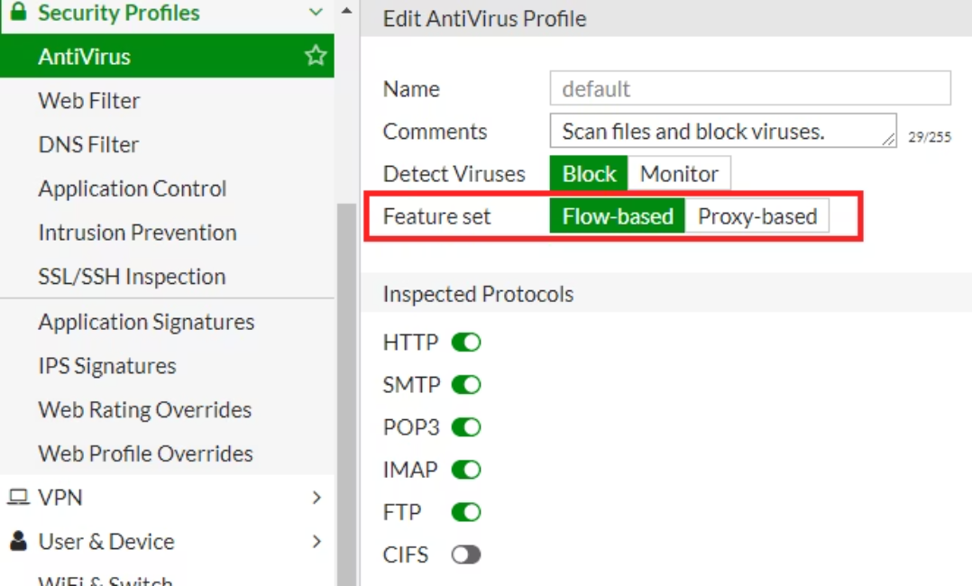
Antivirus
Purpose and Function :
Inspection Modes :
Checks files and traffic for viruses, malware, and other bad software.
Flow-based: Checks traffic while it moves. Faster but with fewer features.
Works with different types of traffic, like web (HTTP), file transfer (FTP), and email (SMTP, POP3).
Proxy-based: Rebuilds the content before checking. More detailed but uses more resources.
Can either Block the threat right away or just Monitor it (only record it for later study).
The Antivirus mode must match the Firewall Policy mode to work correctly.
If a file looks suspicious, it can be sent to a sandbox (a safe, separate place) to test its behavior.
General Configuration Steps
Go to Security Profiles > AntiVirus and make a new profile.
Give the profile a clear name and description.
Turn on scanning for the needed protocols and choose the action.
Pick the inspection mode: Flow-based or Proxy-based.
(Optional) Connect with FortiSandbox for advanced threat analysis.
Link the profile to the Firewall Policy that controls the traffic.

Slide 4
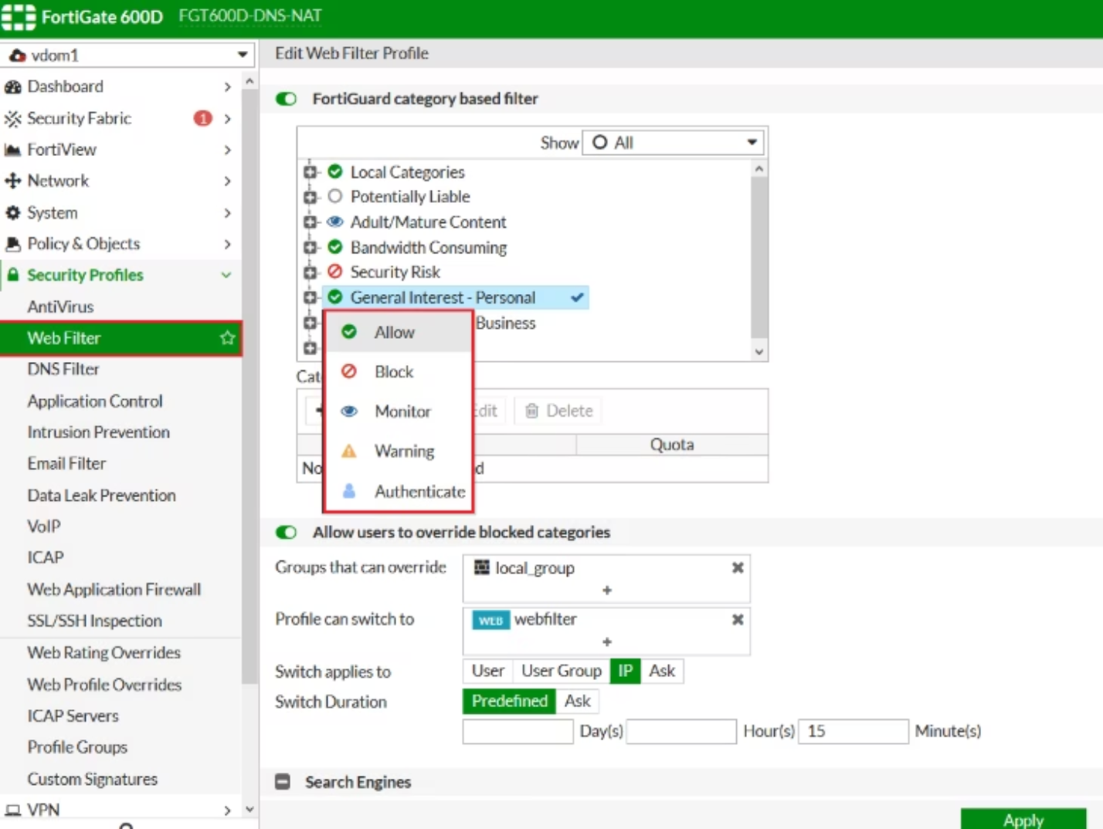
Web Filter (Controlling Web Access)
Purpose and Function :
Decides which websites people can open (like social media, chool sites, or blocked content).
Uses FortiGuard Web Filtering with a big updated list of website categories
Can block certain websites (by URL) or certain words in pages
Actions: Allow, Block, Monitor, Warning, or Ask to log in.
Extra options: force Safe Search and let admins by pass the block.
General Configuration Steps
Go to Security Profiles > Web Filter and create a new profile.
Select categories to allow, block, or monitor based on your organization's policy.
Configure static URL filters for specific websites that need explicit handling.
.
Configure content filters to restrict access based on specific keywords or phrases.
Attach the newly created Web Filter profile to the relevant Firewall Policy.

Slide 5


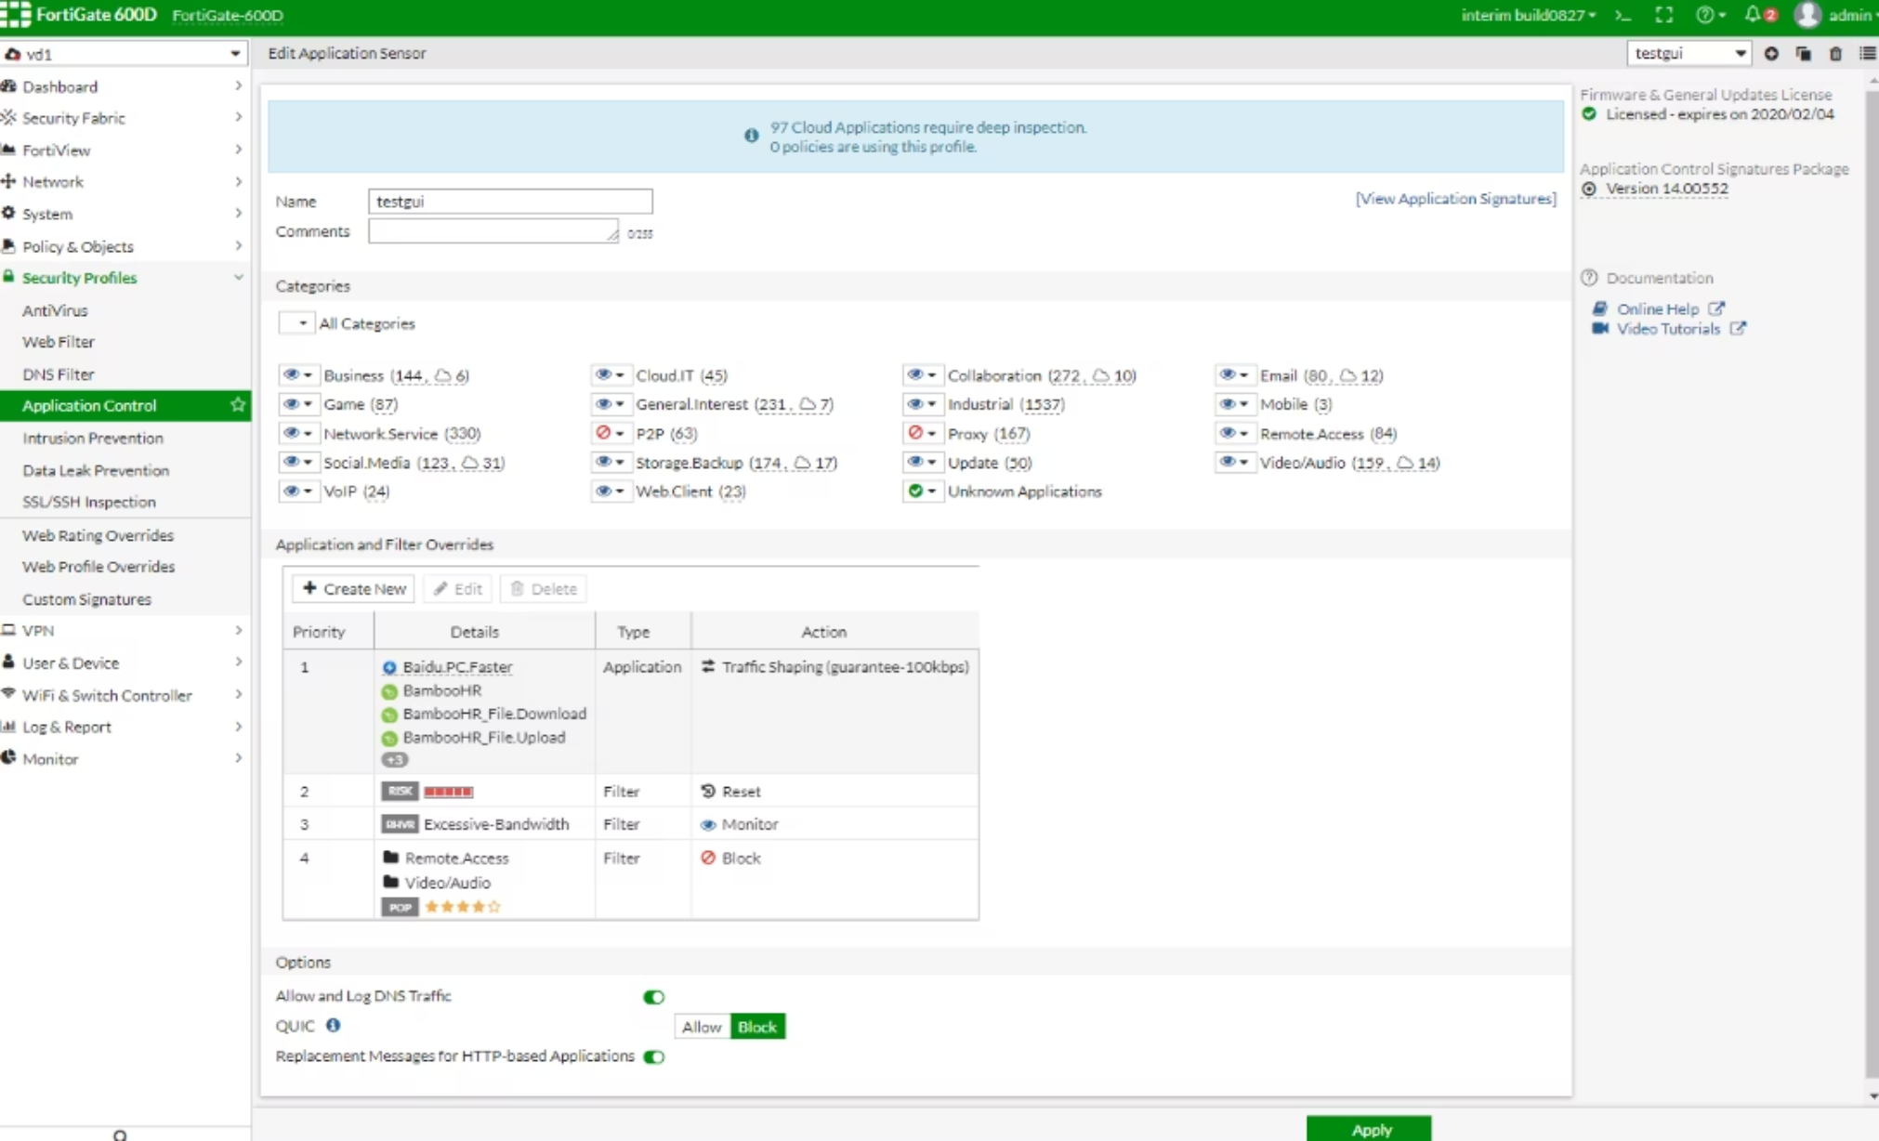





Application Control: Granular App Management
Configuration Steps
Go to Security Profiles > Application Control and create an application sensor.
Define Categories
Choose app types (like Social Media, P2P, VoIP) and set what to do: Allow, Block, Monitor, or Quarantine.
Set Overrides
Add overrides if specific applications or users require exceptions to the general policy.
Attach to Policy
Add the application sensor you set up to the right Firewall Policy.
5 Enable SSL Inspection
Turn on SSL Inspection if apps use encrypted traffic, so the firewall can see everything.

Slide 6




Order of Execution
When a Firewall Policy has multiple security profiles (AntiVirus, Web Filter, App Control, IPS). traffic is inspected in a logical sequence to ensure comprehensive protection.
Application Control
Web Filter
Identifies and manages applications regardless of port.
Controls access to websites based on categories and content.
AntiVirus
IPS
Scans for and neutralises malware and viruses.
Detects and prevents intrusion attempts and exploits.
The inspection order follows: Application Control → Web Filter → AntiVirus → IPS.

Slide 7





Best Practices for FortiGate Security Profiles
Regularly Update
Ensure all signatures and FortiGuard services are consistently updated to protect against the latest threats.
Enable Logging
Turn on logging for all security profiles to gain crucial visibility and facilitate efficient troubleshooting.
Balance Performance
Optimise the balance between inspection depth and network performance to avoid bottlenecks.
Implement DoS Policies
Utilise denial-of-service (DoS) policies to filter illegitimate traffic early and mitigate attacks.
Periodic Review
Conduct regular reviews of your security profiles to adapt to evolving network requirements and threat landscapes.

Slide 8

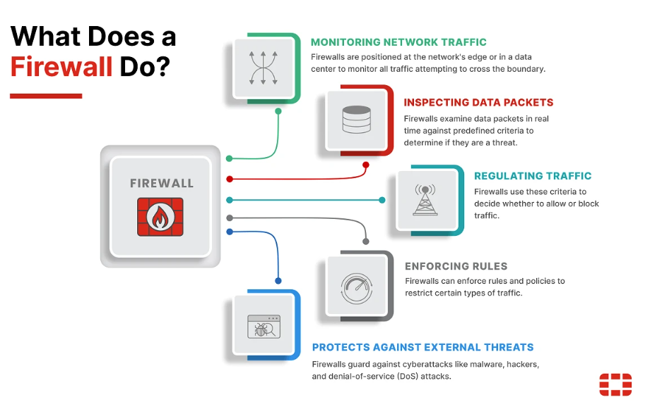
FortiGate Security Profiles: Network’s First Line of Defence
FortiGate Security Profiles provide strong and flexible layered protection, adapted to your network needs.
Flexible Layered Protection → Customized for your network traffic and risks
Intelligent, Adaptive Security → Adds advanced capabilities to firewall policies
Stay Ahead of Threats → Use FortiGate profiles for proactive defense against new threats

